Slide 1
Qt Graphical User Interface
Always Look on the PySide of Life ☺
Notes:
???

Slide 2
Event Handling: Derivation
To handle events via derivation, we can override virtual methods.
from from PySide2.QtWidgets import *
class MyLabel(QLabel):
def mousePressEvent(self, event):
pos = (event.pos().x(), event.pos().y()))
print("Pressed: (%d, %d)" % pos)
def mouseReleaseEvent(self, event):
pos = (event.pos().x(), event.pos().y()))
print("Released: (%d, %d)" % pos)
…
Virtual Handler | Description
dragEnterEvent | Drag enters widget
dragLeaveEvent | Drag leaves widget
dropEvent | Drop event completes
enterEvent | Mouse enters widget
leaveEvent | Mouse leaves widget
Notes:
3.5 min

Slide 3
Slots & Signals
Qt’s variant of the observer pattern uses signals and slots.
from PySide2.QtWidgets import *
from PySide2.QtCore import Signal
from threading import Thread
class AppWindow(QMainWindow):
signal = Signal()
str_signal = Signal(str)
app = QApplication()
window = AppWindow()
button = QPushButton(window)
count = 0
def when_clicked():
Thread(target=start_thread).start()
def start_thread():
global count, window
count = count + 1
window.signal.emit()
window.str_signal.emit(str(count))
button.clicked.connect(when_clicked)
window.signal.connect(lambda: print("Hello"))
window.str_signal.connect(button.setText)
window.show()
app.exec_()
Signals are necessary to cause action in the GUI thread from outside. Note: signals can only be declared within QWidget subclasses!
Notes:
This will be needed for Exercise 4!
11 min

Slide 4
Event Filters
We can use a more traditional observer model via event filters.
from PySide2.QtCore import QObject, QEvent
from PySide2.QtWidgets import *
from PySide2.QtGui import QPixmap
Type = QEvent.Type
class MyAppClass(QObject):
def eventFilter(self, obj, event):
if obj and obj == label:
if event.type() == Type.MouseButtonRelease:
mouse_release_event(event)
elif event.type() == Type.MouseButtonPress:
mouse_press_event(event)
elif event.type() == Type.MouseMove:
mouse_move_event(event)
return False
def mouse_release_event(e):
print("Rel: (%d,%d)" % (e.pos().x(), e.pos().y()))
def mouse_press_event(e):
print("Prs: (%d,%d)" % (e.pos().x(), e.pos().y()))
def mouse_move_event(e):
print("Mvd: (%d,%d)" % (e.pos().x(), e.pos().y()))
app = QApplication()
(window := QMainWindow()).setGeometry(0, 0, 320, 320)
(label := QLabel(window)).setGeometry(10, 10, 300, 300)
label.setPixmap(QPixmap("snakes.jpg"))
my_object = MyAppClass()
label.installEventFilter(my_object)
window.show()
app.exec_()
To use Qt event filtering, the filter class must derive from QObject.
Notes:
This is *also* be needed for exercise 4 (for mouse events)!
6 min

Slide 5
Input Validators
We can limit inputs to valid variants using input validators.
from PySide2.QtWidgets import *
from PySide2.QtGui import QIntValidator
app = QApplication()
(window := QMainWindow()).setGeometry(0, 0, 320, 480)
(line := QLineEdit(window))
line.setText("100")
line.setValidator(QIntValidator(1, 100, line))
window.show()
app.exec_()
Generally, input validators check the text with every keystroke!
Notes:
This might also come in handy for Ex4… ☺
3.5 min

Slide 6
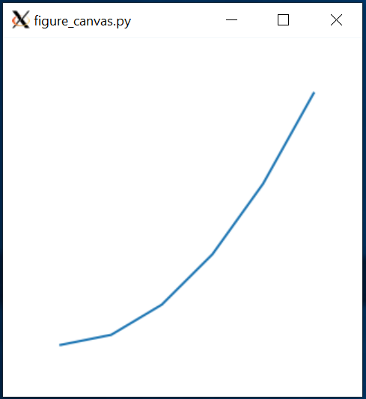
FigureCanvas Widget Classes
Matplotlib has widget classes for several GUI toolkits.
from PySide2.QtWidgets import *
from matplotlib import pyplot
from matplotlib.backends.backend_qt5agg \
import FigureCanvasQTAgg as FigureCanvas
app = QApplication()
window = QMainWindow()
window.setGeometry(0, 0, 320, 320)
figure, axes = pyplot.subplots(1)
axes.set_axis_off()
axes.plot([x – x ** .5 for x in range(0,10)])
canvas = FigureCanvas(figure)
window.setCentralWidget(canvas)
window.show()
app.exec_()
Notes:
4.5 min

Slide 7
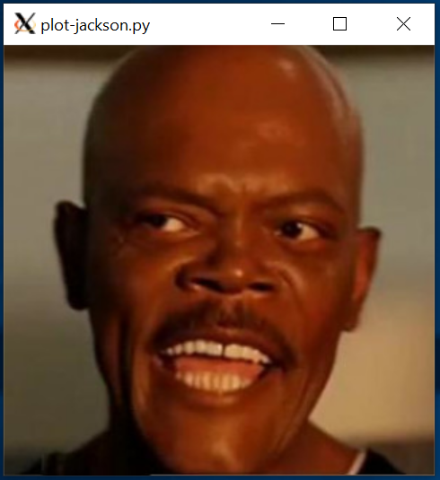
Drawing Pixel Plots
Matplotlib can also read and draw images.
from PySide2.QtWidgets import *
from matplotlib import pyplot, image
from matplotlib.backends.backend_qt5agg \
import FigureCanvasQTAgg as FigureCanvas
app = QApplication()
window = QMainWindow()
window.setGeometry(0, 0, 320, 320)
figure, axes = pyplot.subplots(1)
axes.set_axis_off()
axes.set_position([0,0,1,1])
jackson = image.imread("snakes.jpg")
canvas = FigureCanvas(figure)
window.setCentralWidget(canvas)
picture = axes.imshow(jackson)
window.show()
app.exec_()
Notes:
The image data is just a matrix; format depends on source. For this jpeg, it is a series of RGB values (0-1). You can also have an array of X/Y
6 min

Slide 8
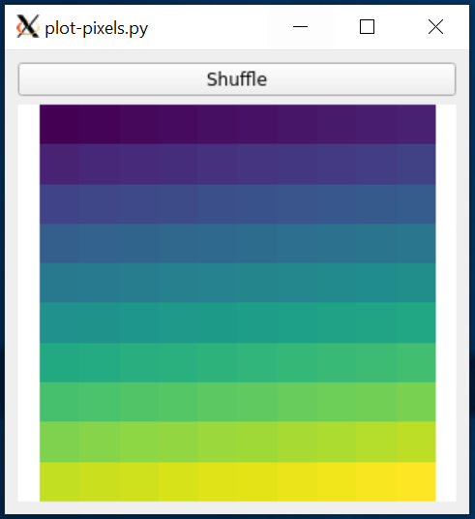
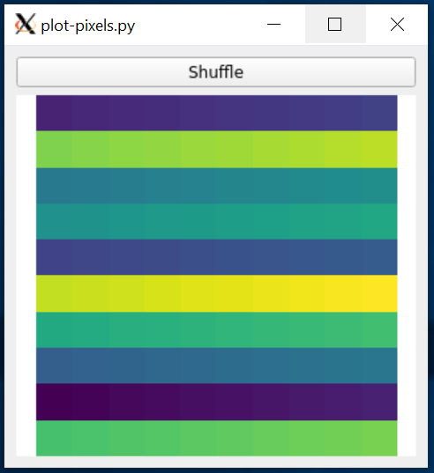
Pixels from Value Range
If the matrix is individual values, Matplotlib will automatically assign colors.
from PySide2.QtWidgets import *
import random, matplotlib.pyplot
from matplotlib.backends.backend_qt5agg \
import FigureCanvasQTAgg as FigureCanvas
def shuffle_pixels():
random.shuffle(pixels)
picture.set_array(pixels)
canvas.draw()
app = QApplication()
(window := QMainWindow()).setCentralWidget(QWidget())
window.setGeometry(0, 0, 320, 320)
layout = QVBoxLayout(window.centralWidget())
layout.addWidget(button := QPushButton(window))
button.clicked.connect(shuffle_pixels)
button.setText("Shuffle")
figure, axes = matplotlib.pyplot.subplots(1)
axes.set_axis_off()
axes.set_position([0,0,1,1])
pixels = [range(i*10,i*10+10) for i in range(0,10)]
layout.addWidget(canvas := FigureCanvas(figure))
picture = axes.imshow(pixels)
window.show()
app.exec_()
Notes:
The image data is just a matrix; format depends on source. For this jpeg, it is a series of RGB values (0-1). You can also have an array of X/Y
7 min

